Slide 1

Houston, TX
2019
#XamDevSummit

Slide 2
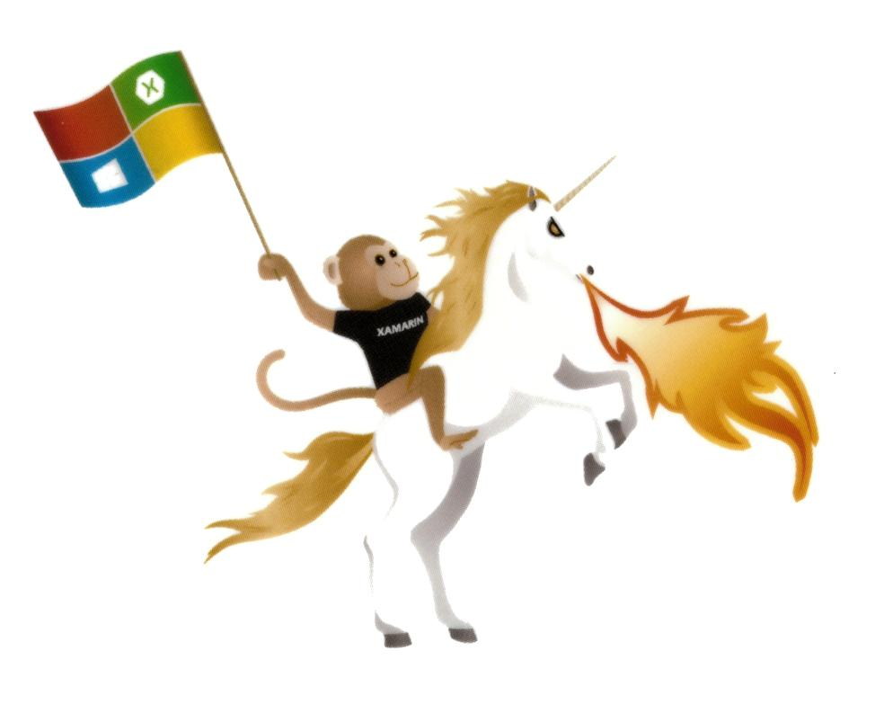

Deliver Your Xamarin App On-Time and On-Budget
Robin Schroeder
RTSchroeder

Slide 3
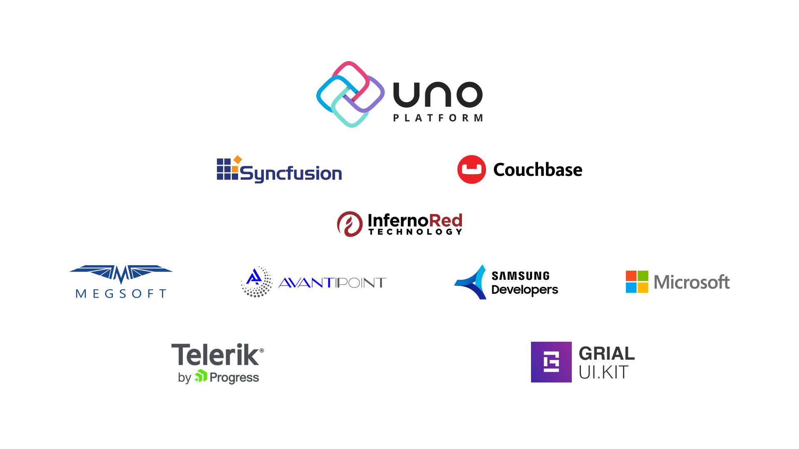

Slide 4

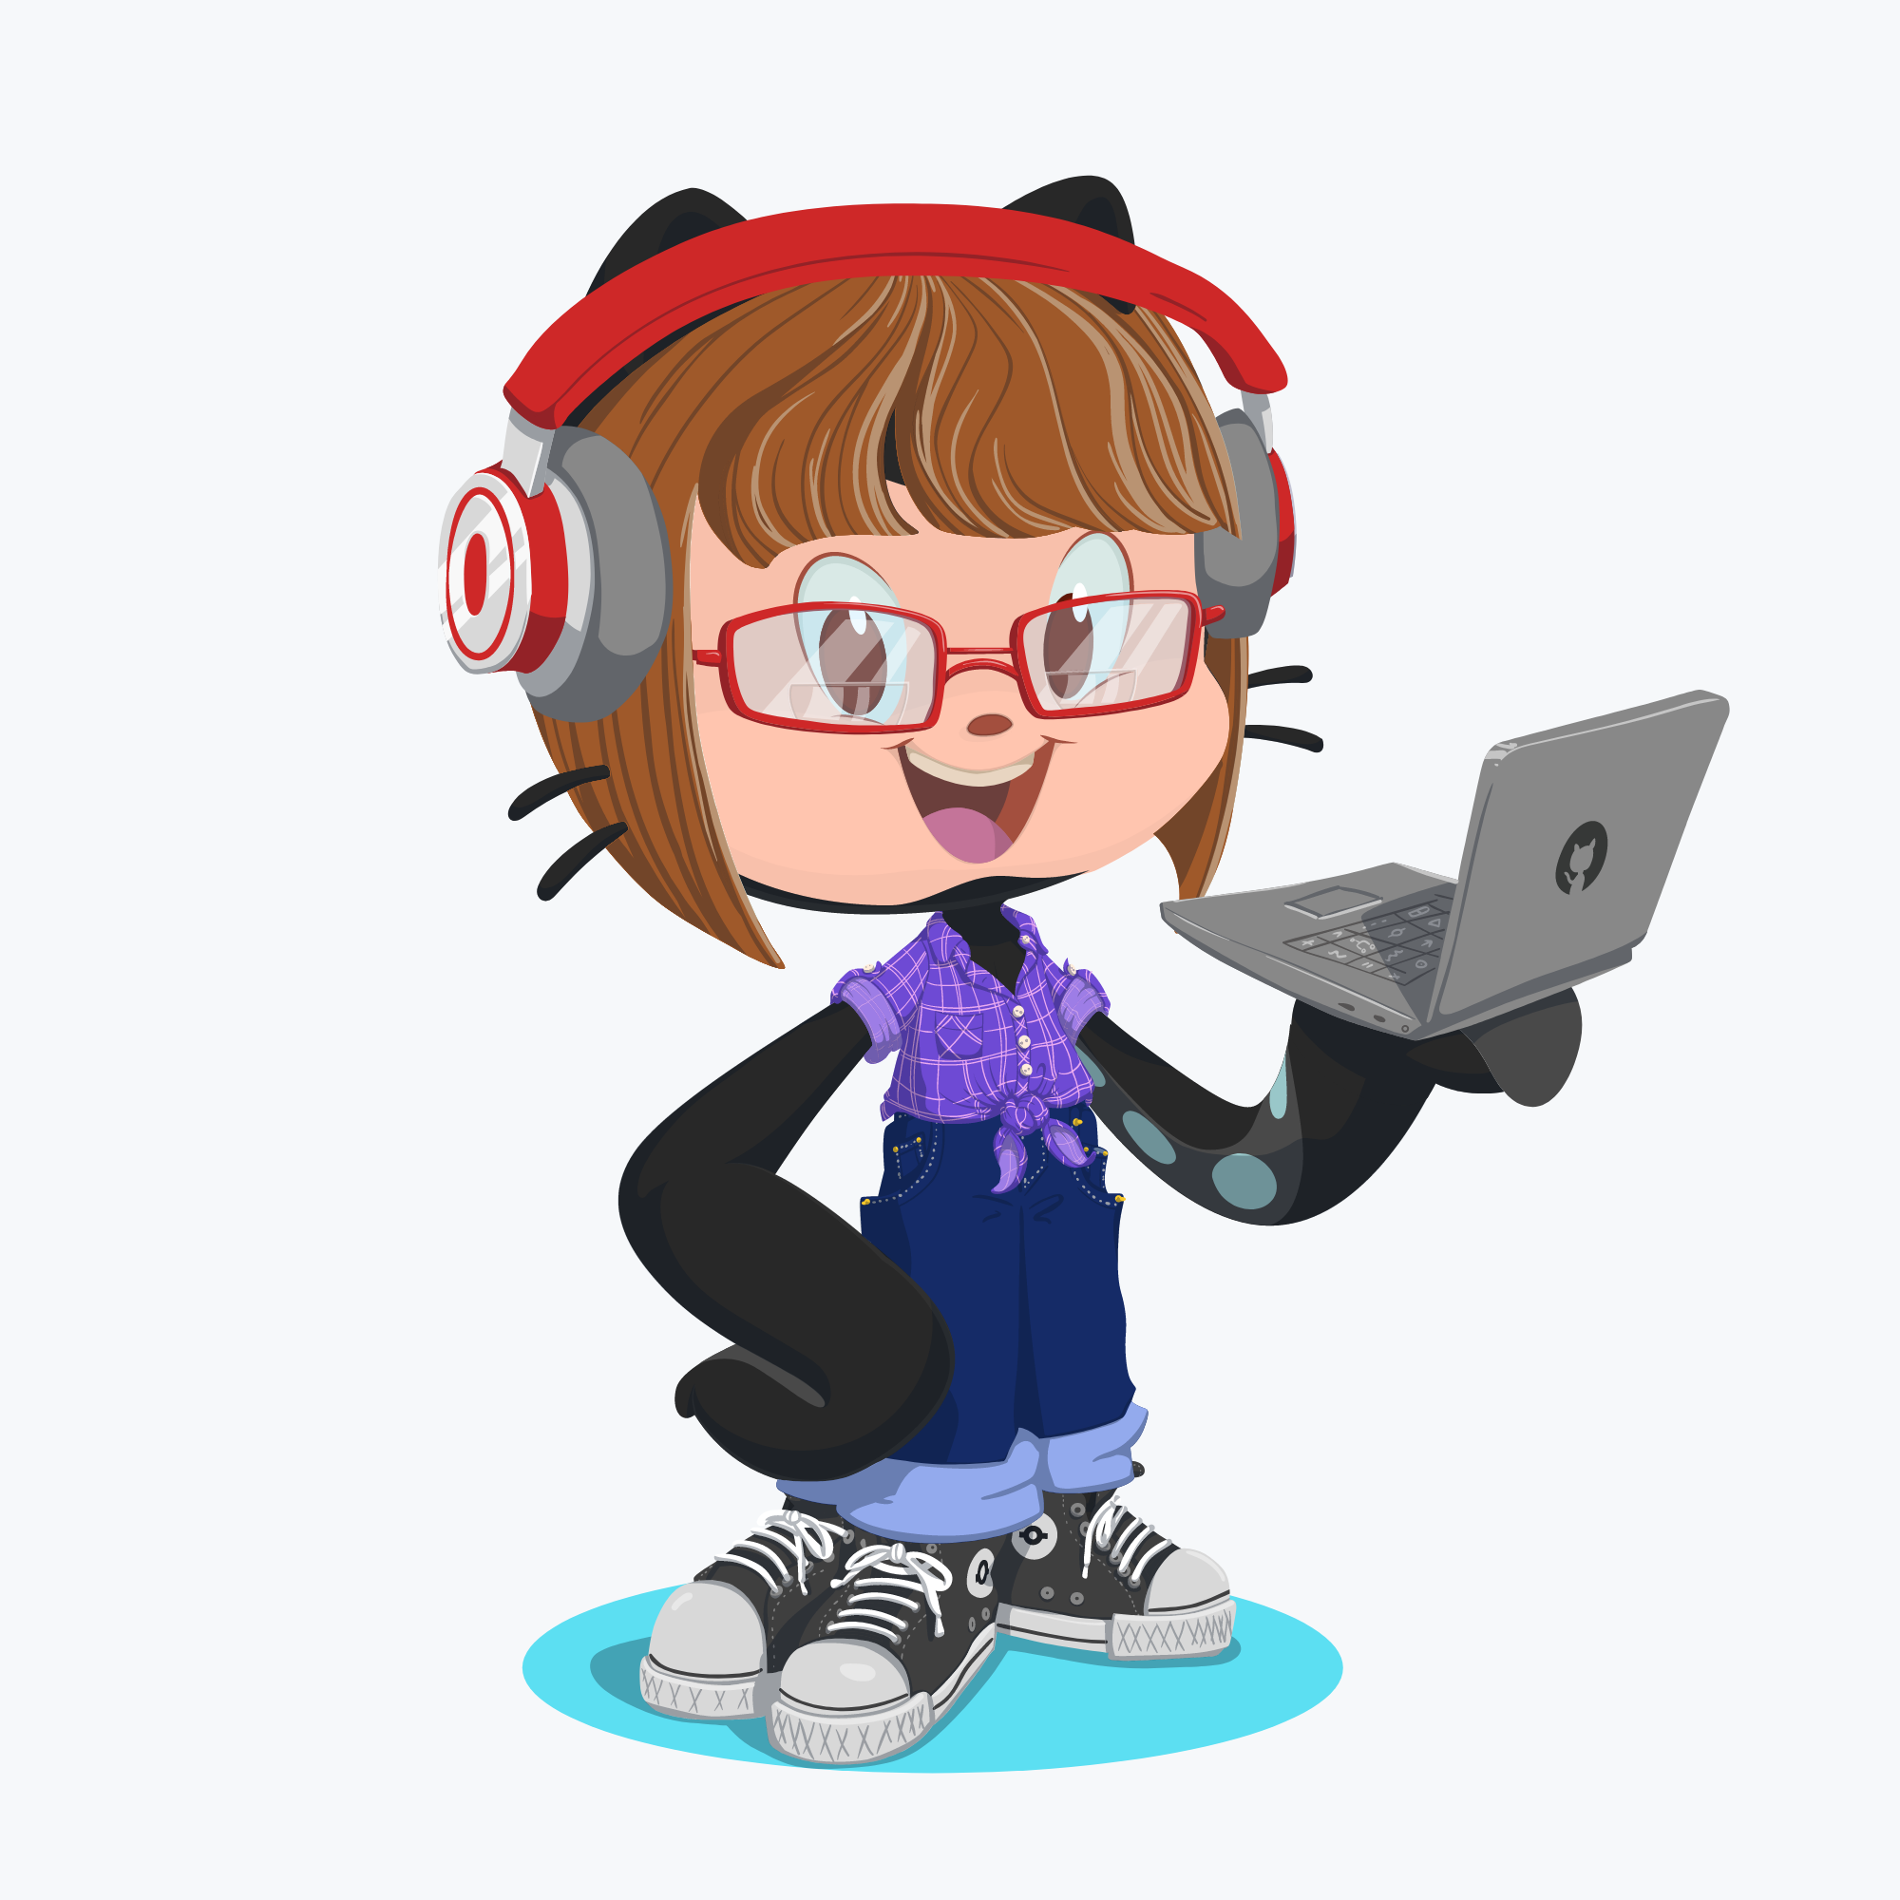
Why are you qualified to talk about this?
I like to
build stuff…
Coding since 1998
VBA, Java, VB6, XML, SOAP, Linux, SQL, HTML, CSS, and JS
In 2008, Switched to C#
Webforms, Win 8.1 Metro Apps, XAML and UWP
In 2015, started Xamarin University
I <3 Xamarin
Lifetime chronic nightmares about being late
Disclosure: I have no affiliation to any of the specific products mentioned in this talk
Our office is in a maker space => Fox.Build
Hobbies: Guitar, Photography, 3D Printing, Ancestry
Fox Valley Girls Coding Club Instructor
“Being a small shop, we have thrived by learning how to do more with less and streamline our approach to software craftsmanship.” -Paul
Notes:
Why am I qualified to talk about this?
I have been writing software for a number of years, switched from a mostly non-Microsoft stack to the Microsoft stack in 2008.
Started with Xamarin University in late 2015.
I really hate being late and as a result, I spend a lot of time thinking about how not to be late.
Over the years I have gathered up a number of practices that are geared towards efficient delivery of mobile apps – hence this talk!
I am a consultant with a small firm. Our office is inside of a maker space & co-working space.
I play guitar lots.
I have been an instructor for a local high school girls coding club for about 3 years now. It’s lots of fun. ☺

Slide 5

What are you going to talk about?
Review research on software delivery
25 Ways to
MAKE IT BETTER

Slide 6

The Research
Let’s get the depressing stuff out of the way…

Slide 7

75% of Software Projects Will Fail
Key survey findings include:
75% of respondents admit that their projects are either always or usually “doomed right from the start.”
80% admit they spend at least half their time on rework.
78% feel the business is usually or always out of sync with project requirements and business stakeholders need to be more involved and engaged in the requirements process.
Only 55% feel that the business objectives of their projects are clear to them.
Less than 20% describe the requirements process as the articulation of business need.
Only 23% state they are always in agreement when a project is truly done.
- Geneca 2017
http://www.geneca.com/why-up-to-75-of-software-projects-will-fail/
Notes:
Back in 2017, Geneca, a software consulting firm, conducted a survey and published a report.
The title of the report was a little sensationalized on twitter and linkedin. Almost presented as click-bait, when it was released online.
Clearly we can’t dismiss this report – lots of truth in here… I would say most everyone here has probably worked on a project that ‘smelled funny’ – you just have a gut feeling you code will probably never reach production for on reason or another.
{read}
Ouch, that hurts.

Slide 8

When Leadership was asked why projects fail…
The Standish Report
Photo credit: https://www.chron.com/neighborhood/article/Plane-crash-reported-in-west-Houston-near-Sugar-13242222.php

Slide 9
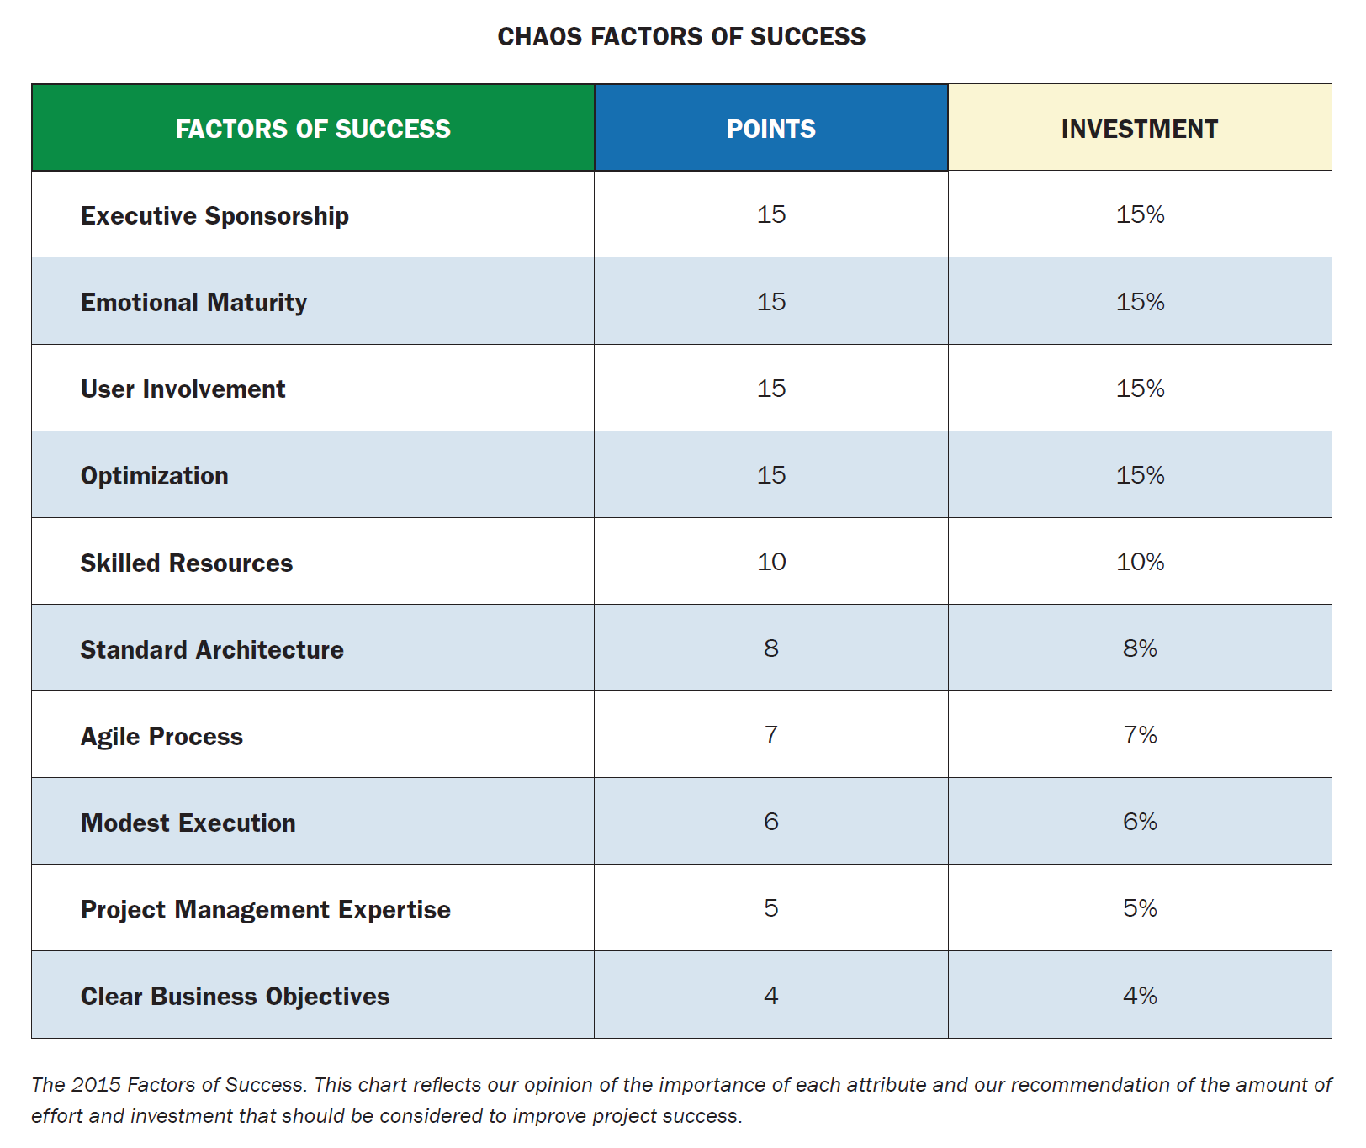
The Standish Group – CHAOS Report 2015
Comprehensive Human Appraisal
for Originating Software
The Standish Group is an international IT Research Advisory Firm. Their CHAOS Report is the result of in-depth surveys on delivering mission critical software projects on-time and on-budget with a satisfactory result.
The Research
Notes:
Basically, the folks over at the Standish Group did an extensive leadership survey and then analyzed, categorized and boiled down their findings into ten weighted ‘factors for success’. Each of these are supposed to represent a category in which leadership should direct resources to improve a software project’s probability of success.
These are the 2015 report results. You can purchase the newer reports online. The 2015 report is free. So if you want to dig into any of these categories in detail, you can do so online.
The Standish Report isn’t the end-all-be-all in this space. It fuels its fair share of ‘healthy discussions’ online.
For the purposes of this talk, I wanted to use these factors to weight and group a series of tips and tricks specifically for delivering Xamarin projects.

Slide 10

25 Ways to Make it Better
Let’s Do This.
Notes:
Ok – Let’s do this.

Slide 11

Communication Cadence
Executive Sponsorship 15%
User Involvement 15%
Clear Business Objectives 4%
~34% of the problem is here
Notes:
The first third of the problem revolves mostly around Communication.

Slide 12
Who is on the Team?
Teams and projects come in lots of different sizes…
Developer (Stakeholder)
User
Stakeholder
Developer
User
Stakeholder
Project Manager
Business Analyst
Developer
Quality Assurance
User
Notes:
If we are going to communicate, let’s review who is usually on the team. Teams come in a lot of different shapes and sizes. They can also fluctuate as a project proceeds. From just an indie dev – maybe you writing a hobby app for the itunes and google play store, to a large enterprise team with a BA, QA and PM. Unfortunately, communication is important for all of these teams.

Slide 13

#1. Weekly Progress Videos and Screen Caps
Make progress videos as you are writing/testing your code. Record and store them as you go.
Use Vysor (Google Chrome Extension) for Android & Reflector 3 for iOS
Use Slack, Teams, Discord or something similar to post your weekly progress videos – make a channel for this specific purpose!
This builds a project diary and avoids lost emails
Stakeholders, BAs, QA, etc. can view, review and share the videos on their own schedule
Notes:
The best way to keep communication channels open between the members of the team is to set a cadence – much like the rhythm of a song – or brushing your teeth every night. Set up some good communication habits and it becomes much easier to keep it going. Agile has a similar strategy with ceremonies…
Tip #1: Weekly Progress videos and Screen Caps
Make progress videos as you are writing/testing your code. Record and store them as you go. Make a habit of making a quick video when merge you branch or make a big commit.
Don’t worry if they aren’t perfect – these videos are intended to show progress, open communication channels and get everyone on the same page.
Use Vysor or Reflector, and there are other screen casting softwares. Use a separate channel in Slack, Teams, Discord to post your progress videos. This builds a project diary and avoids lost emails. C-level Execs are busy and so are you!
Picture this – you are walking down a hallway, on your way to a meeting. A co-worker, tangential to your project stops you to ask how the project is going. Now you don’t have to launch into a summary of what is going on – just invite them to check out your ‘Progress Video Channel’.
Additionally, they have the ability to chime in with inline comments. Starting a conversation, where are conversation is needed.
How to get the cadence rolling and engage a stakeholder that is too busy for their own good?
Explain this process and set this expectations when the project starts
Set a recurring reminder to post videos every Friday morning
Set a recurring reminder to check for response every Wednesday (PM) – basically giving a time limit for comment - acknowledgment
If Stakeholders have not commented on videos by Wednesday of the following week, schedule a meeting! – once they figure out they can avoid another meeting by reviewing your work… they may choose to engage on their own time!

Slide 14
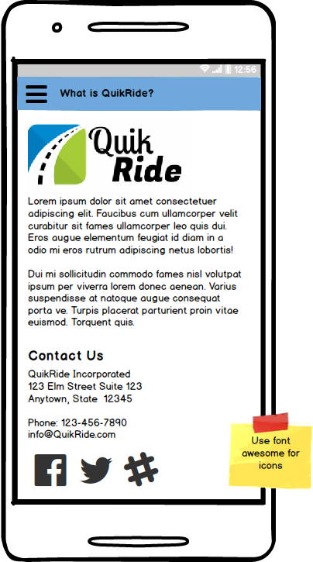
#2. Do Not Write Any Code Without a Mockup
Low-fidelity mockups speak a thousand words
Helps to ignite a conversation, where one is required
Rarely attracts “you’re wasting time” pushback
Low Fidelity Mock-ups helps team members understand that the mockup is NOT A SCREEN CAPTURE.
The hand drawn-ish look help team members understand that the design is flexible, not set in stone.
Example: Balsamiq or just a whiteboard drawing!
Notes:
Tip #2 Whatever the project situation is, from verbal-only requirements to extremely detailed written requirements, a low-fidelity mockup or wireframe speaks a thousand words.
Helps avoid dreaded requirements surprises
Helps to ignite a conversation, where needed
Developers often get push-back if they try to formally document missing requirements, but especially in the absence of good requirements, Low Fidelity Mockups get the job of documenting what needs to be written very quickly, and rarely attracts “you’re wasting time” pushback.
Low Fidelity Mock-ups helps team members understand that the mockup is NOT A SCREEN CAPTURE.
The hand drawn-ish look help team members understand that the design is flexible, not set in stone.
In contrast, High Fidelity mockups are typically what a graphic designer would build. Try to reserve High Fidelity Mockup Software – MockPlus, Fluid UI, Moqups, JustinMind, etc. for designers – it can get really tedious.
DO NOT write any code without a mockup

Slide 15
#3. Make and Use a MUST KNOW List
Android, iOS and UWP?
Persistent Storage – online/offline mode
Globalization & Localization
Authentication & Authorization
Should any device permissions block the user from using the app? Location, camera, push, etc.
Analytics and Crash Reporting
API Versioning & API Authentication
Distribution – iTunes/Google Play or Enterprise
Any accessibility concerns?
Any company specific best practices?
Any specific color, branding or other UI considerations?
Any unique requirements? HIPAA? Other security concerns?
Notes:
Tip #3 : Make a MUST KNOW LIST
Even if you have fairly detailed written requirements, make a MUST KNOW LIST of high level items that could potentially impact your architectural decisions. Make a point to ASK EACH ONE and, if necessary, describe in detail what you mean, if needed. Do this before any code is written.
You would be surprised what can be learned about requirements when stakeholders are specifically asked these types of questions.
This is my list, please feel free to use it or make your own.

Slide 16
#4. Early UAT for Stakeholders
Give Stakeholders an opportunity for Early User Acceptance Testing
Use a QA device with sample data only. No exposure to APIs. Keep it as low risk as possible.
It gets them involved. They get to know the project. They feel more like they are in the ‘inside’. They are more apt to share with other executives in-between meetings. They give better feedback. Word travels about your project. Interest and excitement build around your project.
Most importantly – this provides a solid starting point for conversations between stakeholders and the development team.
This practice dramatically reduces surprises.
Notes:
Tip #4 Early User Acceptance Testing
Give Stakeholders an opportunity for Early User Acceptance Testing
Use a QA device with sample data only. No exposure to APIs. Keep it as low risk as possible.
It gets them involved. They get to know the project. They feel more like they are in the ‘inside’. They are more apt to share with other executives in-between meetings. They give better feedback. Word travels about your project. Interest and excitement build around your project.
Most importantly – this provides a solid starting point for conversations between stakeholders and the development team.
This practice dramatically reduces surprises.
OK – sounds good. So… how is this done gracefully and without wasting a bunch of time?

Slide 17

#4. Early UAT for Stakeholders
Notes:
When I set expectations for early UAT with stakeholders – I tend to explain it this way:
“Let’s think about the early UAT app as if we were setting out place-settings on a dinner table. We are going to get the UI and all of the user interactions ‘just right’ with static, mocked-up sample data – think of this as the plates, cups, silverware, etc – or in this case, the flower vase and the empty wine bottle. Then, I am going to rip the tablecloth out from underneath and replace it with data from the server. The plates and cups and silverware are all going to stay in the same places, but the underlaying data source is going to be replaced with the middle-ware and backend API endpoints and Database.”
OK OK… and so I ask again… how exactly is this done gracefully and without wasting a bunch of time?

Slide 18
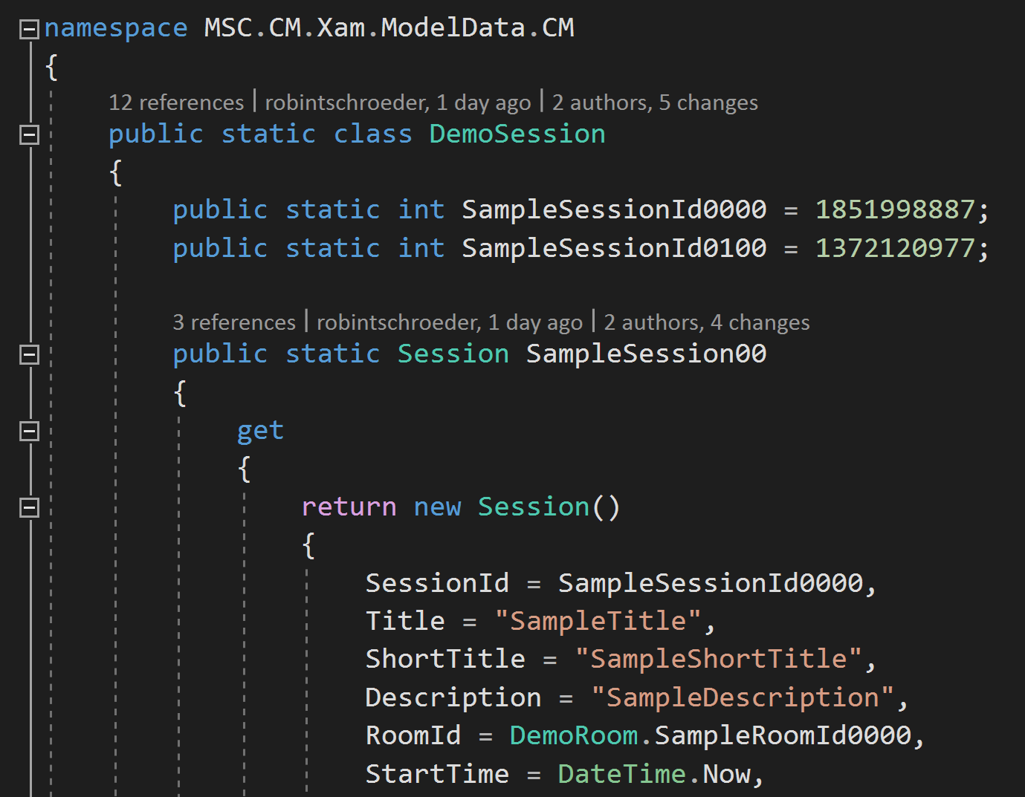
#4A. Invest in Sample Data
Take the time to create at least one set of static classes with sample data
Use these for unit tests, and for building out the UI for early UAT
Use fictional character names, dead presidents, cartoon characters, movie stars – this drives home the point that the back end is NOT wired up and NOT complete.
Notes:
First step to delivering an Early UAT version of the app to stakeholders, you need to invest time in building out sample data.
You are going to need it for unit tests, anyway, so build it in such a way that you can use it for both.
Analogous to the sample data we used to build in the olden-days, when dinosaurs ruled the earth, for WPF apps Win 8.1, vanilla non-Xamarin UWP, for the Visual Studio Designer or Blend.
If you use any sort of code generation, this is a great candidate for a template. Mainly because this is a ‘one-and-done’ opportunity for code generation. You typically don’t re-gen sample data.
I usually use static classes with static ids separated out, so that I can reference them from other objects if I need to.

Slide 19
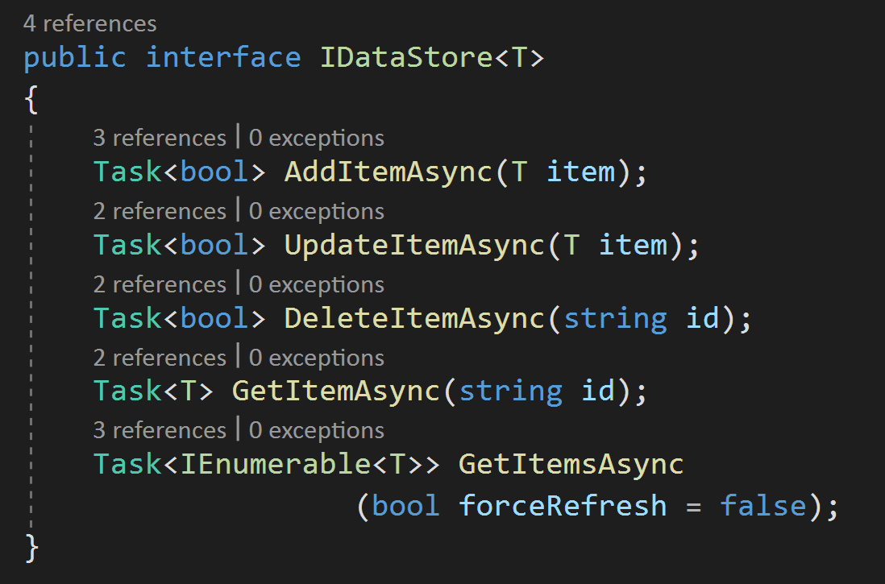
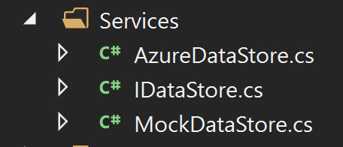
#4B. DI Your Data Loading and Data Store
Vanilla Data Store
Notes:
I didn’t bring a helmet and so I am going to try not to get tomatoes thrown in my general direction. So, in an effort not to bring different XF architectures and frameworks into the mix… I am going to start with a basic, brand new Xamarin.Forms app in VS 2019, the shell template gives you an IDataStore interface with two implementations – AzureDataStore and MockDataStore. This contains CRUD (Create – Read – Update – Delete) methods for the models. This example doesn’t have a persistent data layer. It just loads API or mock data into memory and serves it up.
The template architecture uses the DependencyService in the App.xaml.cs to toggle between the Mock data and the API.
Ok – cool, let’s start here.

Slide 20
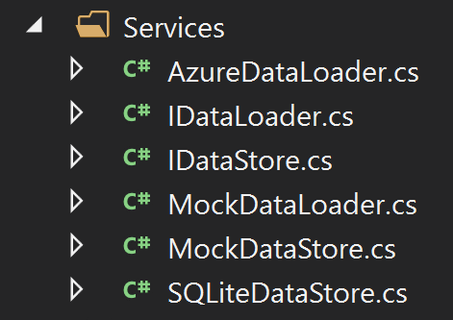
#4B. DI Your Data Loader and Data Store
Break up the Data Store
SQLite Storage
Mock Data Loader
Azure Data Loader
Sample Data
Mock Data Store
SQLite Data Store
Notes:
If we break out the process of loading of the data from the process of serving the data to the UI, we can use dependency injection to swap out the loading implementation (tablecloth), without disturbing any of the dishes (UI).
You can also load the UI directly from the MockDataStore. This is useful if you have time sensitive or security sensitive data that is never stored in persistent storage.
This is pattern is super powerful. It enables us, as developers, to provide a UI that is basically functional to stakeholders without investing time and energy building out a backend database, API layers, nor the middle-ware data sync layers. It honestly really just becomes the dishes on the table.
MOST IMPORTANTLY : By providing this to stakeholders EARLY in a project, it gives THE BUSINESS time to think about it and it gives US developers more time to react to changes. We should EXPECT changes, not dread them. And I think we would all agree: if you have to change the plan, it is easier to change early in a project than late in the game.

Slide 21
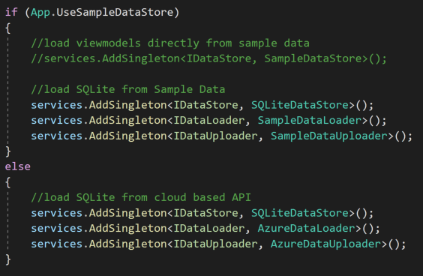
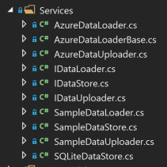
#4B. DI Your Data Loader and Data Store
Breaking it up a little more
Notes:
Taking it one step further, here is the service layer when the process of uploading data is broken out as well.
Using the default DI container in .Net Core, you can see that the services are registered as singletons.
Namespace: Microsoft.Extensions.DependencyInjection

Slide 22

#4. Early UAT Comparison
Notes:
In contrast – what often happens is that as development proceeds, the dev team is reluctant to demo until things are ‘perfect’. Demos are done in sprint review meetings, in dev or QA. Stakeholders are only able to view the app through the nursery window and comment off the cuff - like a new parent looking at a newborn baby in the hospital, squinting at a distance, and then declaring that the baby looks “exactly like their Aunt Rose”. It’s the “look but don’t touch” strategy.
Under the EARLY UAT scenario, once the app has passed QA and is actually in UAT, any changes to requirements must be negotiated, ramifications must be worked out hastily and usually incur code debt and bugs.
I think we have all seen developers use this as a strategy, on purpose, to discourage changes to requirements. Almost a sense of – “Don’t make your lack of planning, my emergency…”
The process of Early UAT gives the business the time to give thoughtful comment and the dev time to react to changes.

Slide 23
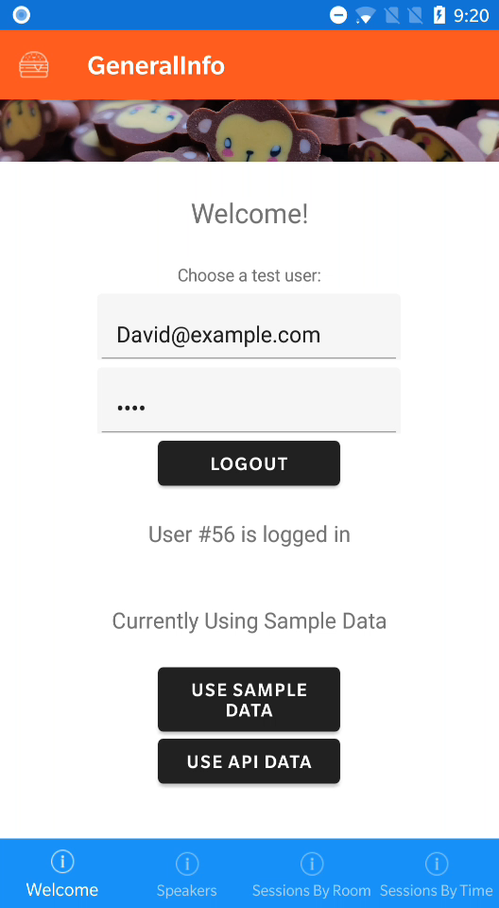
#4. Early UAT
For a code sample of this
pattern, please see the
ConferenceMate soln in the
Speaker Git repo.
Notes:
Video shows first swapping from Sample Data to API data and back again.
To do this, I need to programmatically log the sample user out, log them back in, drop all of the SQLite tables and then rebuild and populate them, using the user’s auth token.
If you want to take a look at the pattern in more detail, check out the “Conference Mate” solution in the Speaker Git repo.

Slide 24

Cultivate Your Knowledge
Emotional Maturity 15%
Skilled Developers 10%
Standard Architecture 8%
~32% of the problem is here
Notes:
{Should be ½ way done with the time}
The next 33% of the problem is with us - developers, our architectures and the general emotional maturity of our development teams.

Slide 25

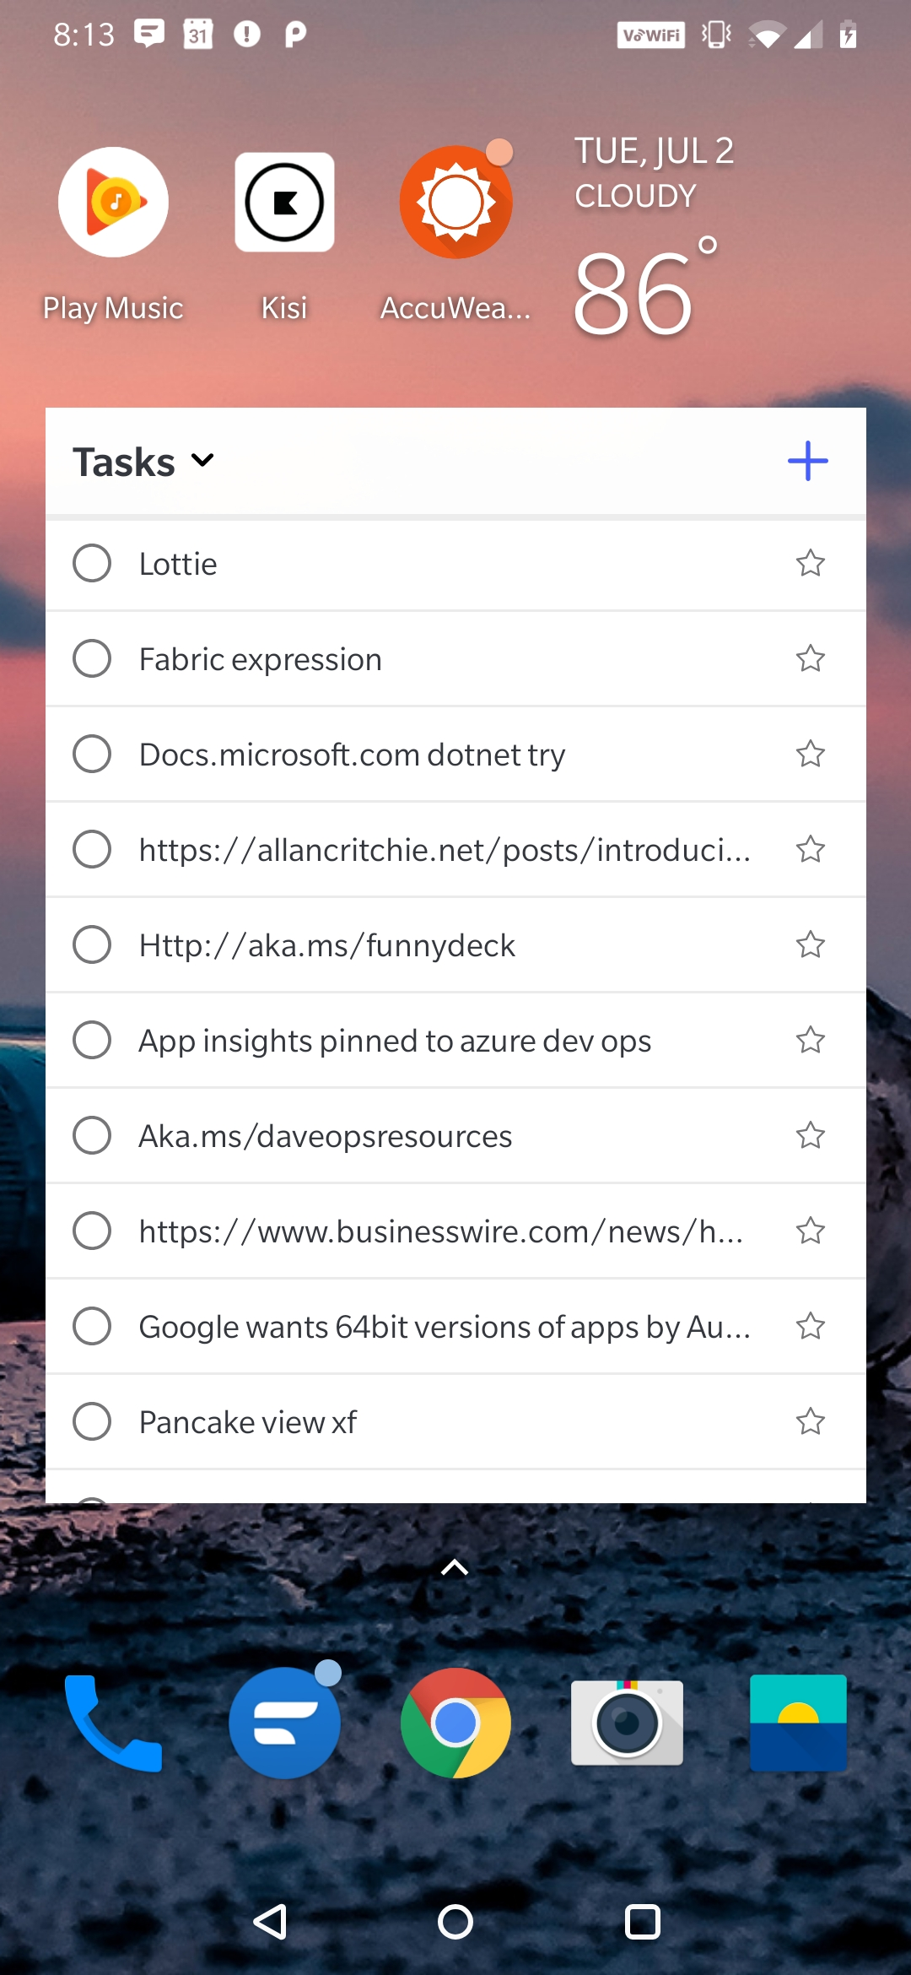
#5. Maintain a Technical ToDo List
The pulse of software development is on Twitter & Blogs
Spend 5-10 minutes daily
Microsoft To-Do mobile app syncs both ways with office 365, & Outlook
Android version has a widget that allows you to put the To-Do List on your ‘desktop’
Next time you have 15 minutes, research something on your list in more detail
Notes:
Tip #5 – The only sub discipline of computer science that seems to move more quickly than mobile is security. As mobile devs we need to be keeping track of an industry that is moving very, very quickly. How can we keep up?
The pulse of software development is on Twitter and Blogs – gone are the days of big fat books. – sorry Dan Hermes – your Apress book is really good… ;-/
Organize your twitter feeds, Wire up a digest for your RSS feeds, if you follow specific blogs
Spend 5-10 minutes daily – flip through twitter – browse your blog subscriptions
When you see something interesting, save it for later
Collect the interesting things you want to research with a screencap or in a todo app
Microsoft To-Do mobile app syncs both ways with office 365, Outlook, https://to-do.office.com
Android version has a widget that allows you to put the To-Do List on your ‘desktop’
Next time you have 15 minutes, research something on your list in more detail either from your laptop, android tablet or phone.

Slide 26
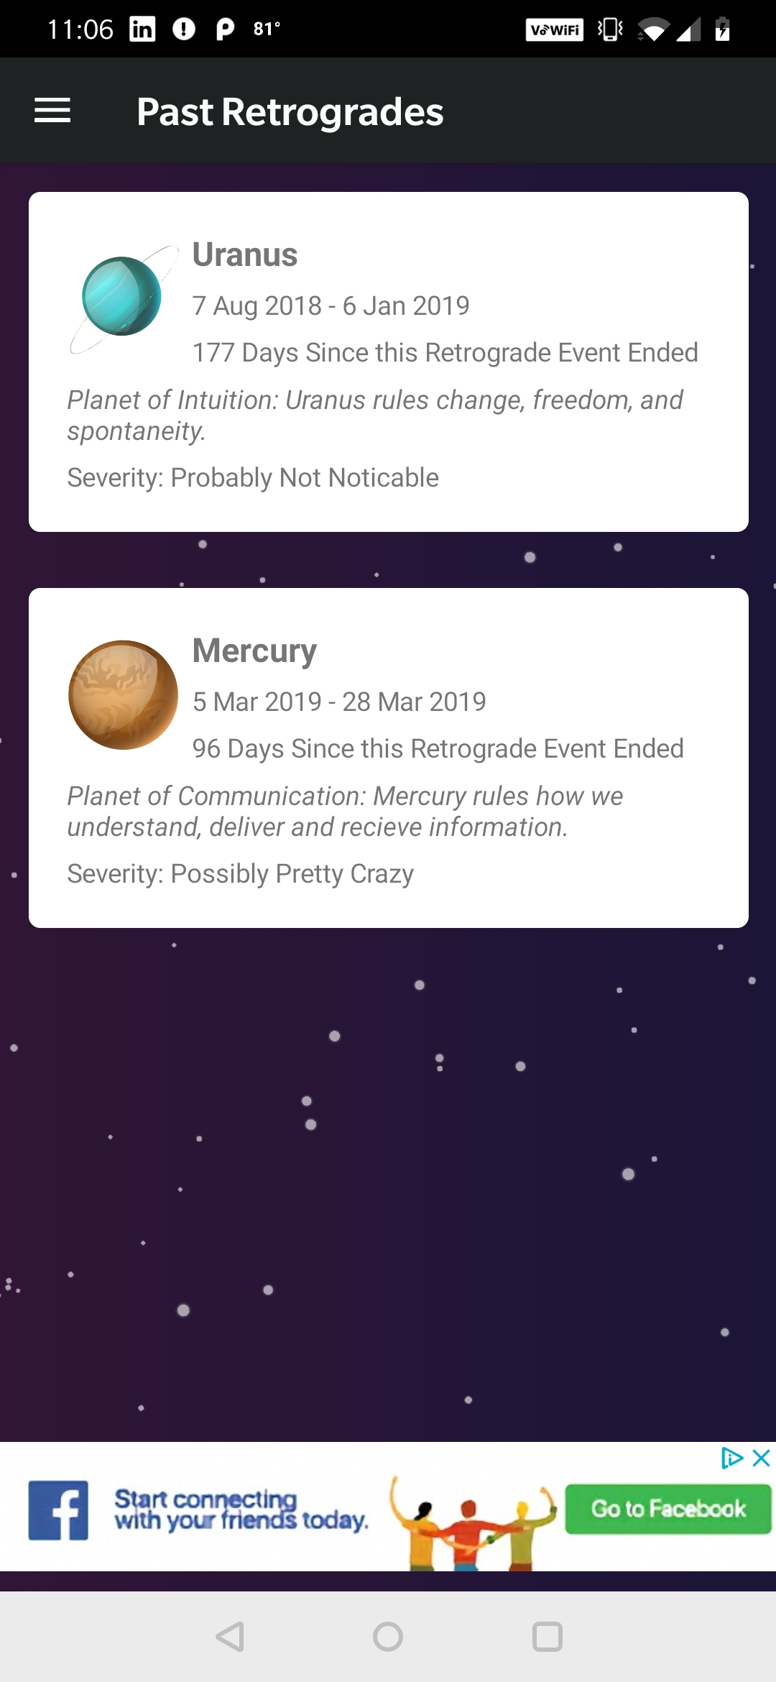
#6. Pet Project App
Take your To-Do list of interesting things and turn it into a Pet project
Pick libraries that you have never used.
It is ok if it never goes to the store(s) or only lives on your personal device.
It is ok to fork and play around
Gives you something to practice on, blog about, talk about in interviews, etc.
Notes:
Tip #6 – give yourself permission to write a pet project app.
I tend to gather up cool things on my to do list and then, because I specialize in relatively boring line-of-business apps, there are certain things I will probably never have the opportunity to use ‘on the job’.
Recently, I used SkiaSharp, Google AdMob and X.F. Shell to build a little app that helps one keep track of the planetary retrogrades. I was feeling like I needed to know when Mercury (especially) was going to go into retrograde because communication on Earth can apparently be thwarted during this time. Let’s be really honest, this is an important thing to know about.
Basically, in short, give yourself permission to build a pet project in which you are the stakeholder!
Pick libraries that you have never used.
It is ok if it never goes to the store(s) or only lives on your personal device.
It is ok to fork and play around
Gives you something to practice on, blog about, talk about in interviews, etc.
This is especially good if you forgot why to you love programming. ;-)

Slide 27
#7. Cultivate Your Emotional Maturity
Before you react or begin to problem solve, take a moment to:
Fully understand how you feel and why
Consider the big picture and everyone’s points of view
Technical solutions aren’t the only way to solve problems
As developers, recognize that we, by default, value logic over emotion – after all, we ‘talk’ to computers all day!
Emotional Maturity vs. Emotional Intelligence
It’s complicated – Google it – Think about it!
Notes:
Tip #7: Standish Report suggests a 15% investment Emotional Maturity for a successful project delivery, at the same time, they valued an Agile Process at 7% - less than half.
This is a sensitive subject – right? As developers, we are introverted, maybe a little socially awkward… or maybe a lot socially awkward? I know I am!
As developers, we have found a lot of success by valuing logic, often valuing logic over feelings.
Years ago, I worked for a good-sized software consultancy. A gaggle of developers were standing over a tower of pizza boxes, with greasy paper plates, discussing past projects. One said,
“I still remember the day I figured out that in order to write good software, humans are required… It was terrifying.”
To become emotionally mature, one has to see the whole picture, both the logical and the illogical parts. It’s hard. Sometimes it is really hard. That’s why you have a team.
Before you react or begin to problem solve, take a moment to go through the following list – in this order:
Fully understand how you feel and why – especially if you are really upset.
Try, try, try to consider the big picture and everyone’s points of view
Technical solutions aren’t the only way to solve problems
As developers, recognize that we, by default, value logic over emotion – after all, we ‘talk’ to computers all day! It’s our super power!
Finally - Emotional Maturity vs. Emotional Intelligence
It’s complicated – Google it – Think about it!

Slide 28
#8. Don’t Set Yourself Up for Failure
Try, try, try to fight our natural, innate excitement for solving problems. Just because you CAN solve a problem, doesn’t mean you SHOULD.
If you are absolutely sure an on-time delivery is not possible, do not be afraid to say something!
Heroics are typically not sustainable.
Notes:
Tip #8 Don’t set yourself up for failure
When new deadlines/scope come your way – try to decipher:
Management setting arbitrary soft deadlines to ‘speed’ up delivery of a project or motivate a team into self organizing and optimizing.
Complete lack of any realistic expectations for a project, leading to absolutely no opportunity for success.
Try, try, try to fight our natural, innate excitement for solving problems. Just because you CAN solve that problem, doesn’t mean you SHOULD. Sometimes it isn’t a problem that should be solved technically, sometimes it would be better solved by a tweak in a business process. Don’t make a business workaround the reason for a software workaround. Think about and discuss the problem as a WHOLE.
If you are absolutely sure an on-time delivery is not possible, don’t be afraid to say something.
There are a number of blog posts touting: “The most important thing a developer can say is NO.” – not sure I completely believe in that, but they are an interesting read.
In general - Heroics are typically not sustainable.
Never, never, never count on heroics.

Slide 29
#9. Celebrate Your Successes
You don’t have to plan a big, premeditated event to celebrate the close of a productive sprint or sending a big feature to QA.
You can pause to post a funny meme in your Slack feed, or buy a round of snacks from the vending machine for your dev team.
Take a minute to stop and say “Hey, we are getting somewhere here… let’s keep going…”
Notes:
Tip #9: Celebrate your Success.
This is an easy one – right!?!

Slide 30

Optimize
Optimization 15%
Agile Process 7%
Modest Execution 6%
Project Management Expertise 5%
~33% of the problem is here
Notes:
The last third of the problem revolves around optimizing the process of execution…

Slide 31

#10. CI, Analytics & Crash Reporting on Day 1
Get your AppCenter accounts set up on DAY ONE of development
Get your simple, debug, simulator CI pipeline set up and successfully building – in Azure DevOps or AppCenter - on DAY ONE
Wire up your build badges to a central place on DAY ONE – maybe the readme of your git repo – so you can quickly see if all of your platforms are successfully building
As you write code, make a habit of adding Analytics as you go.
Notes:
Tip #10 Continuous Integration, Analytics and Crash Reporting
Get your AppCenter (or whatever you use) accounts set up on DAY ONE of development
Get your simple, debug, simulator, master/dev branch CI pipeline for all of the platforms you will support, set up and successfully building – in Azure DevOps or AppCenter or wherever - on DAY ONE
Wire up your build badges to a central place on DAY ONE – maybe in the readme of your git repo – so you can quickly see if all of your platforms are successfully building
Figuring out what is botching an automated build is time consuming:
Make a modification
Commit –> Triggers a build
Wait
Rinse and Repeat
If you wire up the automated build from DAY ONE. The build will more likely succeed out of the gate. Now you are starting from a state in which your project was already building successfully. When the build now breaks, it is easier to figure out what the problem is.
Don’t worry about build minutes – build on every push – your time is more important
AppCenter can generate the build badge code for you, you just cut and paste.
As you build out the code, you now have the right environment to collect meaningful analytics...

Slide 32
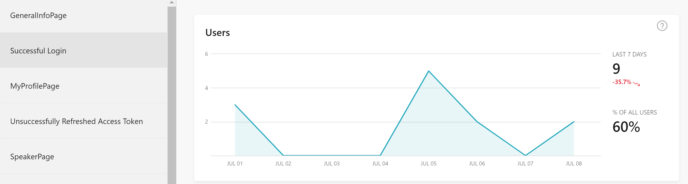
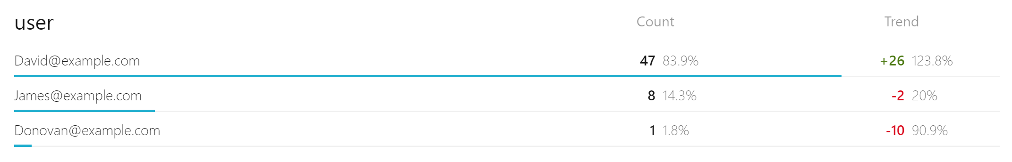
#10A. Meaningful Analytics
Notes:
Wire up analytics on day one and build out meaningful analytics as-you-go.
Keep the event name short and sweet.
Keep any details in the string dictionary (or whatever your analytics platform uses).
Invest some time in working with this data in Application Insights so you get the most out of the data you are collecting. It is a powerful tool!
In the above example, had I included the userEmail in the event name, the analytics would be relatively unusable and messy. This way, I can very quickly tell – in the last 7 days, I have had 9 user sessions, with a total of 56 login events. The following three users logged in… etc.
As you write code, make a habit of adding Analytics as you go – don’t leave this until the end of the project!

Slide 33
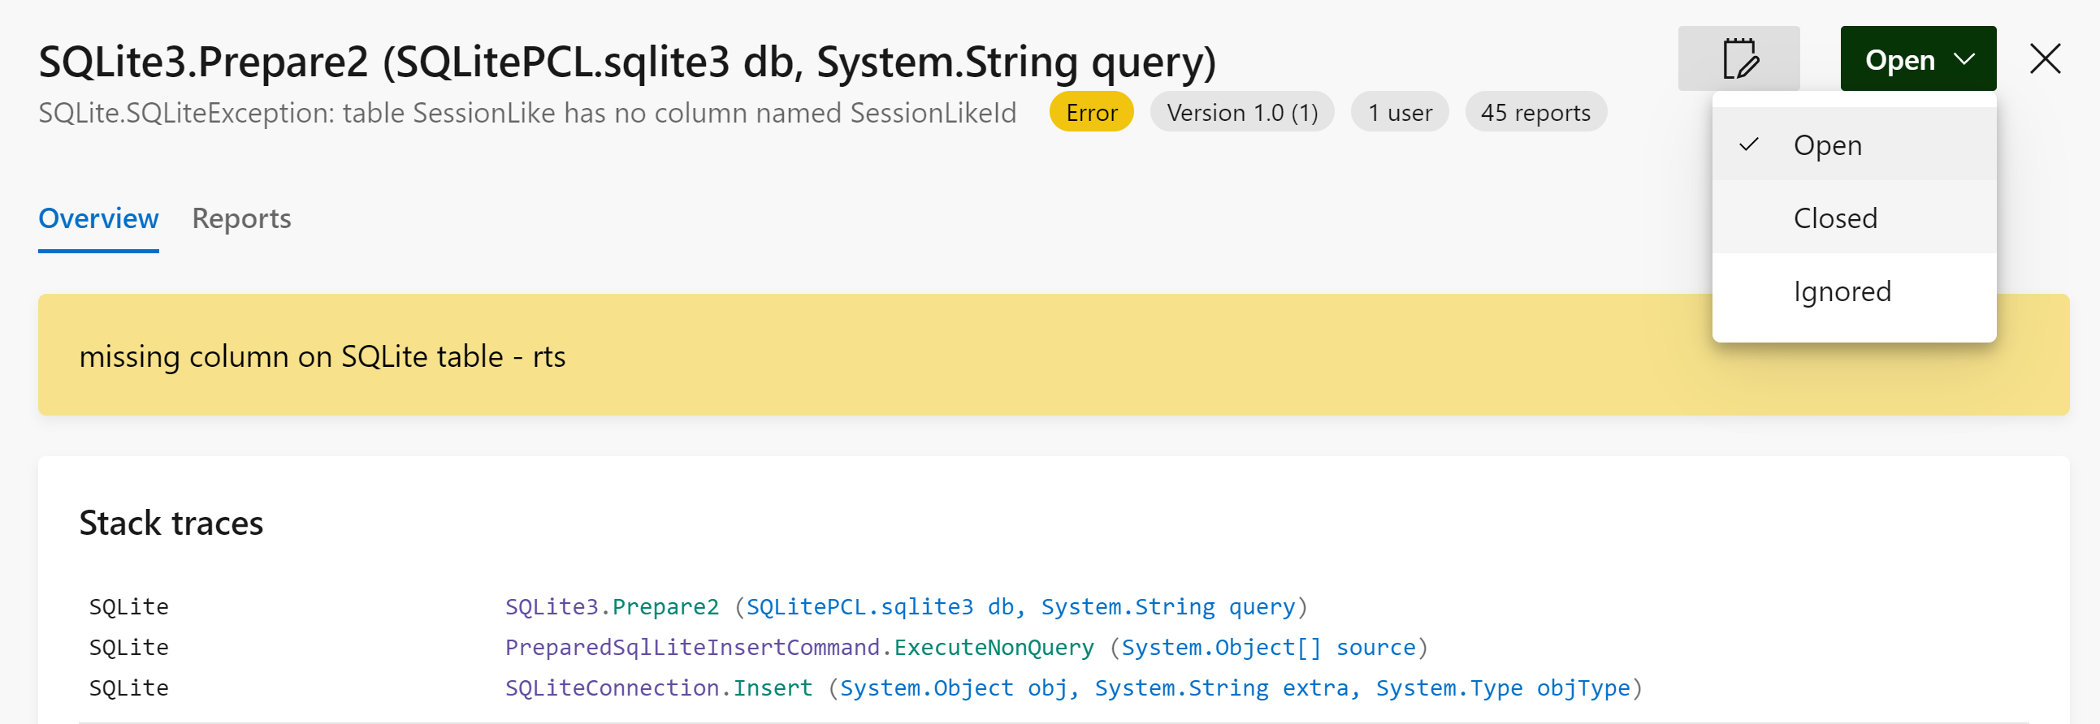
#11. Monitor Crashes
AppCenter has a notes feature for crash groups – use it!
AppCenter has an open/closed feature for crash groups – use it!
Notes:
Tracking down crashes takes time and often pulls in multiple devs.
Again, wire up crash reporting on day one.
If you are the team lead, keep your eye on crash groups to see if anyone on your team is chasing their tail.
Having this history allows you to identify patterns. Each of these represent a potentially frustrated, spinning developer.
Spot check this in the first 10 minutes/last 10 minutes of each day.

Slide 34
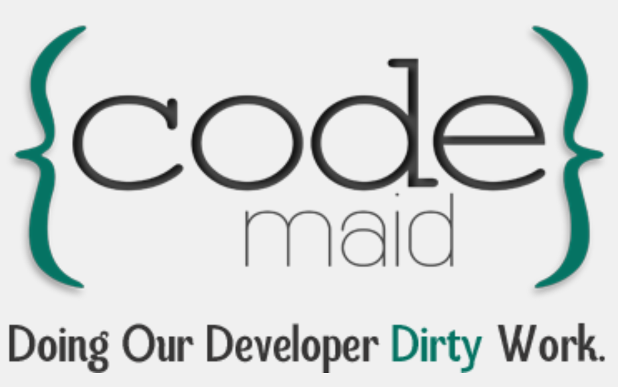
#12. CodeMaid – Avoid Merge Conflicts
Botched Merges Cause Delays – often involving multiple developers!
Agree on an auto code-cleaning tool that your whole dev team will use
Auto Clean on Save
Auto Reorganize on Save
Alphabetize members of the same group
Notes:
Tip# 12: CodeMaid for VS 2019 on a PC
Botched Merges Cause Delays – often involving multiple developers!
Agree on an auto code-cleaning tool that your whole dev team will use
Auto Clean on Save
Auto Reorganize on Save
Alphabetize members of the same group
MAJOR reduction in Merge conflicts! Major time savings.

Slide 35
#13. Identify the Hard Parts and TimeBox POC
Identify any specific technical challenges and/or high risk tasks
Allow yourself a specific amount of time to research and/or create a POC
At the end of that period of time, find a team member and talk about your findings and decide what to do next
Try not to ‘spin’ on a particular problem, by yourself, for too long
Notes:
Tip #13: Identify the Hard Parts and TimeBox POC
POC = Proof of Concept
Identify any specific technical challenges and/or high risk tasks
Allow yourself a specific amount of time to research and/or create a POC
At the end of that period of time, find a team member and talk about your findings and decide what to do next
Try not to ‘spin’ on a particular problem, by yourself, for too long

Slide 36
#14. Build an MVP with “Good Bones”
MVP = Minimum Viable Product
Just enough features to satisfy the user’s base needs without investing in a long development cycle. This allows for the collection of feedback from users to decide what direction the development to go next.
The Hard Part:
Build this base functionality MVP with a good architecture upon which you will continue to build.
Don’t count on ‘reworking’ the base architecture after the MVP is complete…
Notes:
Tip #14: Build an MVP with “Good Bones”
The use of an MVP strategy is widely used and applauded in the Standish CHAOs report.
MVP = Minimum Viable Product
Just enough features to satisfy the user’s base needs without investing in a long development cycle.
This allows for the collection of feedback from users to decide what direction the development to go next.
The Hard Part:
Build this base functionality MVP with a good architecture upon which you will continue to build.
Don’t count on ‘reworking’ the base architecture after the MVP is complete…
In other words:
DO NOT confuse a POC (Proof of Concept) with an MVP (Minimum Viable Product).
DO NOT count on ‘reworking’ the base architecture after the MVP is complete…

Slide 37
#15. Push Business Rules Back
Add at least one Unit Test project to your solution on DAY ONE of development
Aim to write your views and view models such that at least the major business rules are pushed further back in the architecture
This allows you to more easily share the code
This allows you to write meaningful unit tests
Add a unit test task to your CI pipeline on DAY ONE
Notes:
#15. Push Business Rules Back
Add at least one Unit Test project to your solution on DAY ONE of development
Aim to write your views and view models such that at least the major business rules are pushed further back in the architecture
This allows you to more easily share the code
This allows you to write meaningful unit tests
In our consultancy, we often aim to re-use the business rules in both the API and the Xamarin app by isolating them in a separate library that can be used by both solutions. I can’t wait for the day when we can share those same business rules with Blazor apps. Oh – that is going to be so cool. ☺

Slide 38
#16. Battle Context Switching
Try to reduce how often you context switch
Figure out WHEN the most productive code-writing block of time lands in your day. Everyone is different. Block this period of time out on your calendar as often as you can. Try to pair up challenging tasks or user stories with these prime productivity blocks of time.
Silence your phone. Earbuds. Noise cancelling earphones. Sign on your door. Set your Skype/Slack/Discord status as BUSY.
Try to figure out the most graceful way to recover from disruption
Sometimes listening to the same type of music or the same album or song over and over can help get you in the ‘state of flow’ faster
Notes:
#16. Battle Context Switching
Try to reduce how often you context switch
Start out by being aware of how often you context switch during the course of a day or a week
Keep a ToDo list of your miscellaneous tasks that should take less than 15 minutes. Try to knock one of these off of the list at the beginning of the day, maybe before stand-up, or perhaps right after lunch.
Figure out WHEN the most productive code-writing block of time lands in your day. Everyone is different. Block this period of time out on your calendar as often as you can. Look at your past check-ins to identify your most productive time of day. Pair up challenging tasks or user stories with these prime productivity blocks of time.
If you are responsible for supporting existing software and writing new software, get a ticketing system for service requests.
Silence your phone. Earbuds. Noise cancelling earphones. Sign on your door. Set your Skype/Slack/Discord status as BUSY.
Try to make it easy to recover from Context switching
Sometimes listening to the same type of music or the same album or song over and over can help get you in the ‘state of flow’ faster after a disruption.

Slide 39
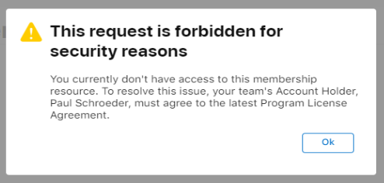
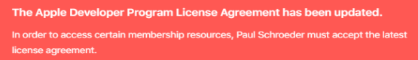
#17. Apple Developer Membership Delays
Anticipate Two Major Delays Related to Apple Developer Accounts:
Initial legal agreements often get stuck in the legal departments of mid to large companies.
Any update to the license agreement will require approval again. Developers are blocked from accessing/modifying provisioning profiles until the legal agreements have been granted approval.
Notes:
Anticipate and Expect delays related to the Apple Developer Membership Program
The Apple Developer Membership program agreements often get stuck in the legal departments of mid to large companies.
Begin the process of acquiring this early – don’t leave it until the last minute.
Apple requires a Dunn & Bradstreet (D&B) number, many companies want to run this through their finance department and this sometimes causes further delays.
DO NOT use this as an excuse to delay iOS dev or testing on your app.
Use the simulator or use/acquire your own membership and dev provisioning profile while they get things figured out

Slide 40
#18. iTunes Submission
The iTunes store is probably allergic to approving an app on the very first try.
Submitting MVPs is sometimes a waste of time, waiting until the last minute can cause major delays.
Set expectations with stakeholders to work early on in the project to figure out how the app should be presented in the store. Edits to these metadata require a human moderated review, even if the archived build has not changed.
If the app is approved, it doesn’t have to be released. You can set the app to ‘manual release’ in iTunes Connect.
Notes:
Tip: #18. iTunes Submission
I suspect the iTunes store is allergic to approving an app on the very first try.
I have been rejected on two recent apps for the following reason:
“The Usefulness of your app is limited by the minimal amount of content or features it includes.”
So, submitting MVPs too early may not be useful.
Submitting too early might be a waste, waiting until the last minute can cause major delays.
Work with stakeholders early on in the project to figure out how the app should be presented in the store. If this metadata needs to be modified, it requires a human moderated review, even if the archived build has not changed. This can lead to you pulling the app from the store temporarily while the metadata is approved by Apple.
If the app is approved, it doesn’t have to be released. You can set the app to ‘manual release’ in iTunes Connect

Slide 41
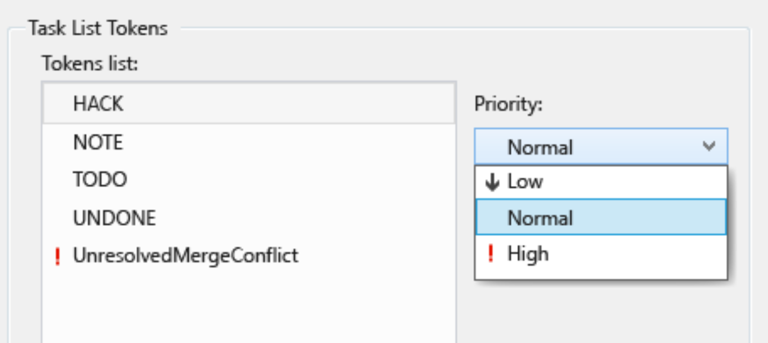
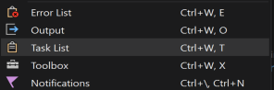
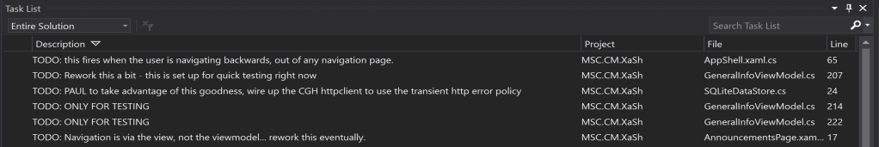
#19. Visual Studio Built In Task List:
Notes:
Tip #19: Use the TASK LIST functionality in Visual Studio –
Use a //TODO, //NOTE, //HACK, //UNDONE, etc or create your own.
You can also modify the priority.
Then have everyone on your team dock the TaskList in Visual Studio.
Check these before you do releases to see if there are any outstanding bits that need attention!

Slide 42
#20. First 10 / Last 10 Minutes
Keep a notebook next to your keyboard. When something pops in your head, don’t distract yourself from coding – jot it down.
First 10 minutes
Check builds and crash reports – this allows you to bring up any problems in stand up
Review notebook
Last 10 minutes
“Scan the horizon” for what can go wrong, calculate probability and mitigate
Update your User Stories and Tasks
Review notebook
Notes:
#20. First 10 / Last 10 Minutes
Keep a notebook next to your keyboard. When something pops in your head, don’t distract yourself from coding – jot it down.
In the First 10 minutes of each day
Check builds and crash reports – this allows you to bring up any problems in stand up
Review notebook
In the Last 10 minutes of each day
“Scan the horizon” for what can go wrong, calculate probability and mitigate
Update your User Stories and Tasks
Review notebook
Capitalizing on the first and last 10 minutes of the day are an attempt to avoid distractions.
Try to complete or delegate those notes/action items at the end/beginning of each sprint.
If they need to linger. Consider turning them into an ‘Issue’ in Jira/AzureDevOps/TFS etc.
Bring this notebook to sit-down meetings. Even if you don’t feel like you are going to use it, people feel better when they see you write it down. Think waiter/waitress at a restaurant.
Don’t expect your project manager/BA to take notes and distribute action items.
RocketBook notebook is amazing.

Slide 43
#21. Avoid Late Summer Public Releases
In summer, scan the horizon for upcoming info from Android and iOS.
Try not to do a public release in late summer without scheduling a bit of time to do some due diligence on any changes to either OS that may have some affect on your app.
Recent Examples:
iOS authentication facial recognition
New bezels, notches, etc.
Changes in location device permissions
Notes:
Tip #21. Avoid La
In summer, scan the horizon for upcoming info from Android and iOS.
Try not to do a public release in late summer without scheduling a bit of time to do some due diligence on any changes to either OS that may have some affect on your app.
Recent Examples:
iOS authentication facial recognition
New bezels, notches, etc.
Changes in location device permissions
te Summer Public Releases

Slide 44
#22. Keep Build Numbers in Sync
Fumbling around to make a hot fix wastes time and introduces risk!
For the sake of sanity, keep your iOS, UWP and Android versions in sync!
Always TAG your repo commits in Git when you do a release
Always make a release branch in Azure Dev Ops/TFS when you make a release – be ready for those high-pressure hot fixes!
Be aware that if you use a CI/CD script to increment the build: the version number is NOT getting into source control!
Be aware of how version numbers are used to filter your app’s analytics
Notes:
Tip #22. Keep Build Numbers in Sync
For the sake of sanity, keep your iOS, UWP and Android versions in sync.
Always TAG your repo commits in Git when you do a release
Always make a release branch in Azure Dev Ops/TFS when you make a release – be ready for those high-pressure hot fixes!
Be aware that if you use a CI/CD script to increment the build, that version number is not getting into source control.
If you only have one set of App Center keys, you can alternate build numbers to cleanly separate dev and prod stats. Odd numbers for dev and even for prod.
If you do an Early UAT release – be sure to increment your version so you can easily distinguish between them in Analytics!
Devise a clean way to build release notes so that you can quickly get a clean list of the improvements made since your last release. Everybody organizes things a little differently. Be able to scan through the commits since your last release, take a look at your sprint items, etc. Think about how you will do this easily.

Slide 45

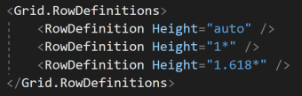
#23. Use the Golden Ratio
Found throughout nature and art, the Golden Ratio is magically pleasing to the human eye
XAML allows for a easy use of the Golden Ratio, with Grid Rows and Columns
You can use any combo of the ratio in whole numbers
For two sections, you can also just use 1 : 1.618
Notes:
Tip: #23. Use the Golden Ratio
If you are dozing off or daydreaming… you might want to perk up and listen to this one… it is a really good way to make your UI look pleasing to the eye without doing a lot of work…
Math to the rescue!

Slide 46

#24. Choose Your Plugins Wisely
When your app requires functionality that can be furnished by an open source plugin…
Does the business require that all plugins are vetted for security purposes?
When was the last time the plugin code was updated on GitHub?
Browse the issues for known problems
Perhaps it can be furnished by a third party plugin…
How often do they release updates?
Browse their knowledge base
Do your due diligence!
Notes:
Tip #24. Choose Your Plugins Wisely
Third party and open source plugins can sometimes be challenging in integrate. Make sure the benefits out weigh the cost.
When your app requires functionality that can be furnished by an open source plugin…
Does the business require that all plugins are vetted for security purposes?
When was the last time the plugin code was updated on GitHub?
Browse the issues for known problems
Perhaps it can be furnished by a third party plugin…
How often do they release updates?
Browse their knowledge base
Do your due diligence!

Slide 47
#25. Synchronize Environment Updates
Everyone on your team should be using the same version of Visual Studio and/or VS for Mac. Discuss and plan for Visual Studio, nuget, dev device SDK and dev machine SDK updates.
Devote one day every 4-6 weeks to updates and smoke testing – usually first day of a sprint.
Make sure you run release builds, with the linker on, to test updates on all platforms
Take notes so you don’t repeat the same version combination next time
Understand this is a long process for a Mac and iOS
Notes:
Tip #25. Synchronize Environment Updates
Everyone on your team should be using the same version of Visual Studio and/or VS for Mac
Discuss and plan for Visual Studio, nuget, dev device SDK and dev machine SDK updates.
Devote one day every 4-6 weeks to update and smoke test – usually first day of a sprint.
Read the release notes!
Make sure you run release builds, with the linker on, to test updates on all platforms.
Take notes so you don’t repeat the same version combination next time
Understand this is a long process for a mac.
Use this time wisely
Groom the backlog, go through your notebook, read up on a POC you need to build, review your requirements and mockups, etc.
Scan the horizon for upcoming challenges

Slide 48
Q & A

Slide 49
Thank You!

